Slide 1
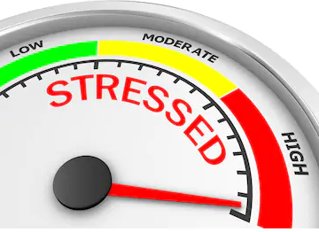
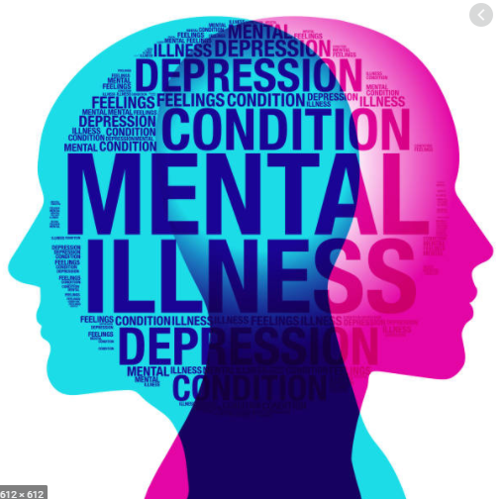
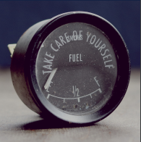
Session 1 * “Managing Stress During COVID-19” *
PREPARED BY N.FUATA

Slide 2
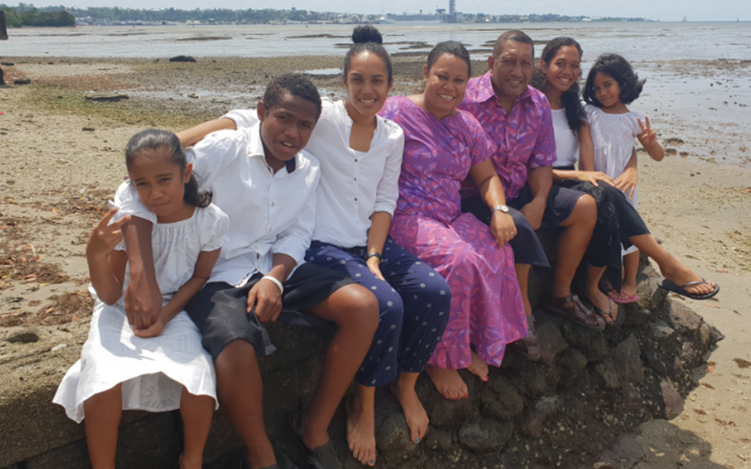
My Family

Slide 3
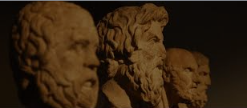
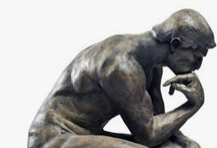
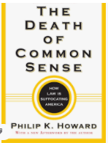
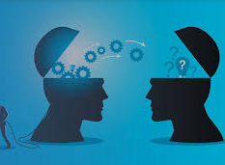

Slide 4
Scope
Definition of Life Coaching
What is Stress?
Good and Bad Stress
Simplified categories of Stressors
Stress and the Role of Perception
Insights
Summary and Discussion

Slide 5
Life is tough and complex. It is better to spend your time preparing for life rather then repairing.
N.Fuata

Slide 6
Definition: Life Coaching
Life coaching is to help people get the most out of life by specifying what is important and pursuing it. Things that are most fulfilling like family, friends, career, love, spirituality, educational goals, plans for time outside work, community engagement, attention to ones mental and physical health etc..
Life is mostly about purpose and meaning. The alternative is misery and suffering which is a bad deal in life.

Slide 7
Question ??
Question: If you were chosen to head a national task force to combat drugs in Fiji among our youth, name the top 3 professionals you would choose from a field of expertise to assist you?
Example: Medical Doctor, Psychologist, Psychiatrist, Police Officer, Lawyer, Military Officer, Rugby Coach, Pastor/Pundit/Mulla etc

Slide 8
What is stress?
Stress
Stress is a feeling of emotional or physical tension.
Stressor
Anything that gets in the way of your goal, or any impediment to your progress forward in life can make you feel scared, frustrated, angry, or nervous.
The emotional experience of stress is ‘Values neutral’ – the outcomes created by the stress whether negative or positive emotions (depending on perception) has no bearing on whether it is good or bad morally.

Slide 9
What is stress?
Level of stress
Five factors that determine your level of stress:
The amount of energy correcting your course
The lack of expertise in correcting your course
Not knowing how long it will take to correct your course
Your perception about life in general
The amount of suffering you allow in your life

Slide 10
Good and Bad Stress
Mental health professionals have clinical terms for good stress and bad stress:
• Eustress: This refers to the circumstances in which something stressful helps inspire, motivate, and enhance your performance. Clinical psychologist Patricia O’Gorman, PhD, refers to this as “challenge by choice”: You make a decision to embrace a stressful challenge.
• Distress: This is the stress that wears you out, leaves you jittery, and can wreck your health, according to a study on the impact of major life events, published in the Malaysian Journal of Medical Sciences. The researchers report that distress leads to overreaction, confusion, poor concentration, performance anxiety, and diminished performance.
Psychotherapists will say that any response to stress depends on perception.

Slide 11
Three Simplified Categories of Stressors
Natural Stressors (Basic Stress)
Relational
Grief/Bereavement
Loneliness/Emptiness
Identity/Self Esteem
Basic Needs
Family Issues
Natural Disasters
Nature

Slide 12
Simplified Categories of Stressors
Developmental stressors (Additional Responsibilities)
Tertiary Studies
Marriage
Starting a new job
Looking after a sick relative
Building a new home
Helping a friend /Relative in financial need
Community work
Love and Attachment

Slide 13
Simplified Categories of Stressors
Unnecessary Stressors (Avoidable Stress)
Bad Relationships/Marriage
Lazy people living with you
Spoilt kids
Alcohol/Drugs
Distorted perceptions
Toxic Home environment
Workaholic
Bad Health

Slide 14
Should you wear shades tonight? N.Fuata

Slide 15
Stress and the Role of Perception
"Our perceptions not any objective reality govern our emotional response and resulting behaviour. Perceptions are based on beliefs, assumptions, values and conditioning. We can dramatically reduce our stress by changing our distorted perceptions. Our distorted thinking can exaggerate our perceived shortcomings. We often paint events much worse, than they actually are by our distorted thinking, this greatly increases our stress . . . . . changing distorted perceptions . . . . is an essential stress management tool."
(Dr Valeri O'Hara PhD, Clinical Psychologist)

Slide 16
Perception and Basic Philosophy
Rational Emotive Behavior Therapy (REBT) is a short-term form of psychotherapy that helps you identify self-defeating thoughts and feelings, challenge the rationality of those feelings, and replace them with healthier, more productive beliefs like ancient wisdom. Albeit Ellis (Psychotherapist)
Rationality vs Emotions – emotions will always win
Emotions make us feel alive, it connects us to the world. It is an integral part of life.
Logic helps us navigate the world cautiously and helps us survive.

Slide 17
Perception and Basic Philosophy
We are 10% what happens to us and 90% how we respond.
By changing your basic philosophy in life you profoundly change your feelings and the way you act.
Common unhealthy philosophy : ‘I must do well or l am no good’….’you must treat me well or you are worthless’…..’the world must give me what l want or it is a horrible place’
What ever happens to us in life does not totally contribute to our emotions. It is largely our belief system. We have the ability to disturb ourselves. We are gullible to bad philosophy (parents, religion etc). We also have the power to change our philosophy by working at it.

Slide 18
Insights
The quality of ones life is dependent on the following:
How much you know about the matters of life (Knowledge)
When to use what you know the right time (Wisdom)
Willing to deal with your suffering (Healing)
Forming a world view that is the closest possible to reality (Philosophy)

Slide 19
Question ??
Question: If you were chosen to head a national task force to combat drugs in Fiji among our youth, name the top 3 professionals you would choose from a field of expertise to assist you?
Example: Medical Doctor, Psychologist, Psychiatrist, Police Officer, Lawyer, Military Officer, Rugby Coach, Pastor/Pundit/Mulla etc

Slide 20
My answer
Question: If you were chosen to head a national task force to combat drugs in Fiji among our youth, name the top 3 professionals you would choose from a field of expertise to assist you?
Example: Medical Doctor, Psychologist, Psychiatrist, Police Officer, Lawyer, Military Officer, Rugby Coach, Pastor/Pundit/Mulla etc
My Answer
Just parents who have raised healthy children who are resilient in life.
Their children have jobs, are involved in community work, married, have their own children, are interested in investments, good citizens etc

Slide 21
Summary and Discussion
Life is tough – always prepare
Choice in life - ‘meaning and purpose’ vs ‘misery and suffering’’
Purpose of the ‘Question’ – most of answers in life is available with people who strive in life. People who make ends meet daily (problem solvers), people who are spiritual, people who give back to their community.
Common stress & Developmental stress (basic life lessons) vs Unnecessary stress (baggages)
Your level of stress is closely related to ‘how much you know’ (knowledge), ‘applying your knowledge at the right time’ (wisdom) and ‘how you view the world’ (Philosophy) and willingness to deal with your suffering (healing)
How we respond to life should be our concern, not what happens to us.

Slide 22
QUESTIONS ????

Slide 23
NICHOLAS FUATA
PSYCH Fuata Consultancy
Email nfuata@gmail.com
Mobile 9367 415
PO Box 13761, Suva

