Slide 1
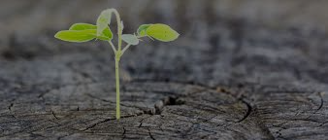
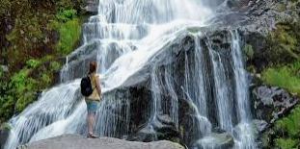
Session 2 * “Hope in the midst of COVID” *
PREPARED BY N.FUATA

Slide 2
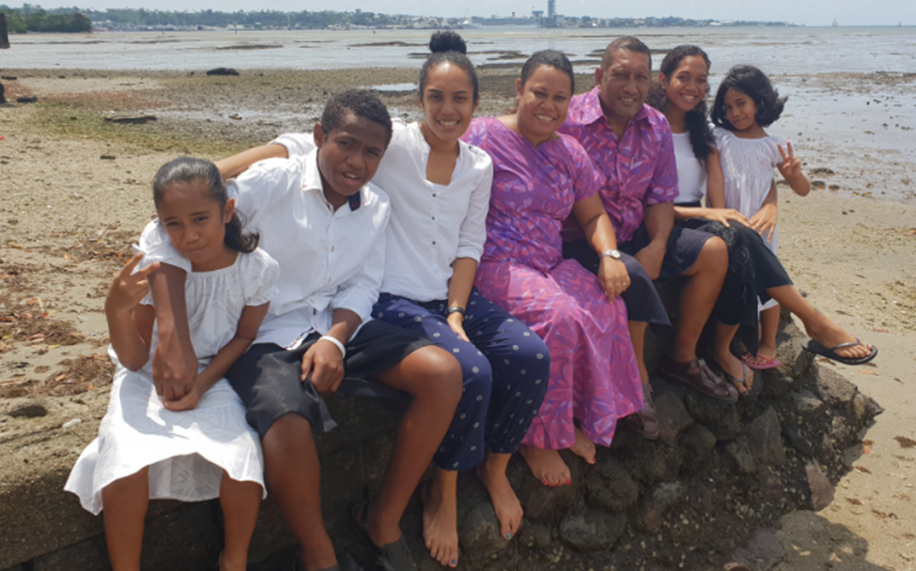
My Family

Slide 3
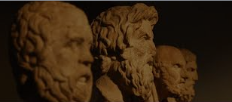
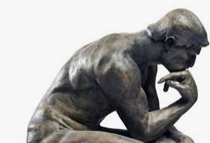
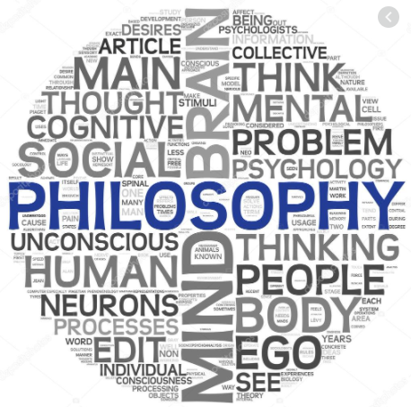
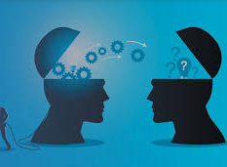
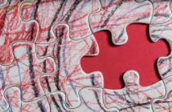
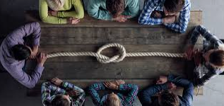

Slide 4
Life Coach
A life coach is an observer of life, a synthesizer who joins the dots to attain the big picture of life. Loves life and people. Helps people face life’s challenges and to live a fulfilled life.
N.Fuata

Slide 5
Scope
Revision
Insights
Shedding light on the Pandemic
Hope
Opportunities
Taking care of your well being
Summary and discussion

Slide 6
If you don’t have a tragic view of life you won’t be happy.
Jorden Peterson (Canadian Clinical Psychologist)

Slide 7
Revision
Life is tough – always prepare
Choice in life - ‘meaning and purpose’ vs ‘misery and suffering’’
Purpose of the ‘Question’ – most of answers in life is available with people who strive in life. People who make ends meet daily (problem solvers), people who are spiritual, people who give back to their community.
Common stress & Developmental stress (basic life lessons) vs Unnecessary stress (baggages)
Your level of stress is closely related to ‘how much you know’ (knowledge), ‘applying your knowledge at the right time’ (wisdom) and ‘how you view the world’ (Philosophy) and willingness to deal with your suffering (healing)
How we respond to life should be our concern, not what happens to us.

Slide 8
Question ???
What is a woman’s greatest need?

Slide 9
Question ???
What is a man’s greatest need?

Slide 10
Shedding light on the pandemic
The pandemic is like a storm on a nation, it uproots and leaves foundations bare. Similarly it strips you and I down to our selves and our abilities.
N.Fuata

Slide 11
Shedding light on the pandemic
The pandemic has caused a recession. Loss of jobs, businesses closing down, economic downturn. All of this has caused panic, anxiety and depression.
Insight: If you remove all the buildings, the air conditioning, the lights, the vehicles, airplanes, flush toilets, escalators etc you will realize that mankind has always ventured to subdue the planet.
We have always attempted to conquer nature. Nature has been rather harsh. We are victims of nature.
The will to survive is always the driving factor. It is all about self preservation and improving our quality of life.
Poor people who became rich was not motivated by money or government assistance. Instinctively they were motivated by the sting of poverty. Poverty limits their options.
It is not the pain and suffering of life that makes us want to take our lives. It is the meaningless pleasure that we pursue.

Slide 12
Hope
Hope is based on what you have, what you lost and can regain (N.Fuata)
The pandemic helped people change for the good. It helped people:
Build better marriages – scarcity helps couples work together, bring resources together to sustain quality of life
Marriage – single people considered marriage to bring their resources together. Poor families marry their daughters off.
Revisit old foes and making amends – forgiveness, moving ahead and helping each other
Spend quality time with family - creates bonding and authenticity with children
Build genuine friendships – by helping people during Covid you find out other areas about them you can care about
Take on a new spiritual journey – rekindle their love for their old belief, change religion/spirituality. Challenge their existing belief system.
Value family, friends and community – social networking and moral support

Slide 13
Hope
The pandemic helped people change for the good. It helped people:
Create long lasting friendships through the hardships – we unite when we face adversity
Revisit cultural values and principles – sharing and helping one another
Value the wisdom of their parents/grandparents – they lived in a harsher world
View hygiene and health in a new way – taking care of our immune system
Remember that their wealth could flow back into the community – you can also work not only to benefit yourself but others also
Those who couldn’t find work found some kind of employment – landscaping, farming, carpentry etc

Slide 14
Retirement Plan
Our retirement plan is the dividends of appreciated love and work that you have invested in your community or family. Their kindness will sustain you in life.
N.Fuata

Slide 15
Opportunities
The pandemic can help change your view on life and business in general:
On how you do business – liquidate and start new business/product, merge business – e.g cattle farmer starts a small butcher, buy a farm
A shift towards our primary industry – fisheries, agriculture and mining of wood, iron, coal and minerals
Watching carefully the movements in real-estate – stats listing of homes, buying properties, via mortgage and raising equity
That total reliance only on salary is not feasible – multiple incomes no matter how small is an advantage
Understanding your nanny may be better off then you - she has support from her vanua, doesn’t have a mortgage, personal loan, vehicle, other expenses

Slide 16
Opportunities
The pandemic can help change your view on life and business in general:
Be a competent worker – companies might stream line intake and will restructure. ‘Survival of the fittest’. The best workers will be retained. Employers might start hiring only males to avoid maternity leave with women.
Remote working online - companies to your benefit, to work at home online. This will help reduce real-estate costs(rent, maintenance etc)
Companies may invest on online tools & software – a lot of focus on IT experience for transition.

Slide 17
Lessons from the wealthy
Most people’s financial formula: Money = Salary earned from a job
Have more then one income, Invest your money
Most people chase money. Wealthy people chase problems and finds a solution.
Always start with a problem. Listen to the market around you
What are people saying they don’t like, what are people saying they wish existed, what are people saying frustrates them, things that are incredibly inconvenient that you can solve. Any problem that is worth solving.
Example: Firewood - Labasa. Muslim man became a millionaire.

Slide 18
Question ???
What is a woman’s greatest need?

Slide 19
Question ???
What is a woman’s greatest need?
LOVE & ATTENTION

Slide 20
Question ???
What is a man’s greatest need?

Slide 21
Question ???
What is a man’s greatest need?
RESPECT

Slide 22
Wellbeing
Healthy philosophy – Life is hard, Life is full of consequences, People struggle with their shadow, Not everyone will love you, Love is not a feeling, Trust and respect is earned, If you learn to respect your parents/elders you will fare well with other authorities in your life, always pursue meaning not happiness
Your body is a pharmacy – your emotions can evoke chemicals in your body that can be beneficial or detrimental e.g case in women’s prison – psychosomatic. Stress and the movement of blood.
Health – know the amazing things about your body – headaches, flu, viruses
Have a spiritual life - self governance, pursue good, forgiveness is beneficial (e.g victims family) find answers to life’s difficult question – who am I, why I am here, what am l here for, what will happen to me after I die, will memories of love be carried over into the after life
Build genuine relationships - have inner circle friends who are wiling to correct you and love you beyond your flaws. Have a strong family not just a good family. Involvement in community work (juvenile – crime, family structures)

Slide 23
Summary and Discussion
It is not the pain and suffering of life that makes us want to take our lives. It is the meaningless pleasure that we pursue
Pandemic has pressed the reset button – relationships, evolving of businesses, new spiritual journey for some
Mankind have always strived to have dominion over the earth and conquer nature
The value of family and community
Seek help from your parents/elders – they lived a harsher life
Improve your knowledge on health
Have a philosophy that’s close to reality
Learning form the wealthy
Observing the new direction businesses are heading

Slide 24
QUESTIONS ????

Slide 25
NICHOLAS FUATA
PSYCH Fuata Consultancy
Email nfuata@gmail.com
Mobile 9367 415
PO Box 13761, Suva

