Slide 1
Fiji Institute of Accountants
SYMPOSIUM ON THE COMPANIES ACT 2015
Dec 2 2015
TOPIC 4
How does a company organise corporate finance?
Presenter: Peter Fulcher

Slide 2
Part One
Securities:
some things new
much that’s tried and true

Slide 3
(new) provisions re shares
no, no, no - a number of nos.
no mem → no authorised cap → no par value (s.193)
(but articles may specify an authorised cap (s.194))

Slide 4
(new) provisions re shares cont
‘limited by shares’
3. ‘Company Limited by Shares’ means a Company formed on the principle of having the liability of its Members limited to the amount, if any, unpaid on the Shares respectively held by them;
PART 38 - WINDING UP GENERALLY
Division 2 - Liability of Contributories
463. Subject to this Part, a … Member is liable to contribute to the Company’s Property to an amount sufficient to -
(a) pay the Company’s debts and liabilities …
464. If the Company is a Company Limited by Shares, a Member need not contribute more than the amount (if any) unpaid on the Shares …

Slide 5
(new) provisions re shares cont
no par value → no share premium account (s.196)
no par value → no stock (s.195)
no bearer shares (share warrant) (s.195)
no capital redemption reserve fund (s.196)
(redemption of redeemable pref shares s.203)
terminology
- share capital
- issued capital
- paid up capital

Slide 6
(new) provisions re shares cont
share attributes – ordinary shares
re meetings
143(1) Written notice of a meeting of a Company’s Members must be given individually to each Member entitled to vote at the meeting …
re vote
161(1) Subject to any right or restriction attached to any class of Shares or any contrary provision in the Company’s Articles of Association, at a meeting of Members of a Company with a share capital -
(a) …
(b) on a poll, each Member shall have one vote for each Share they hold.
re dividend
209. Each share in a class of shares in a Public Company shall have the same dividend
rights unless -
(a) the Company’s Articles of Association provide for the shares to have different dividend rights; or
(b) different dividend rights are provided for by Special Resolution of the Company.
re winding up
490. [on winding up assets applied in paying creditors] ‘and, subject to such application, must be distributed among the Members according to their rights and interests in the Company unless the Company’s Articles of Association otherwise provide.’

Slide 7
(new) provisions re shares cont
share attributes – ordinary shares
place it in the articles
e.g. Schedule 2 – standard form articles
31. Subject to this Articles of Association and to the terms of issue of Shares, all Shares attract the following rights, privileges and conditions—
(a) the right to receive notice of and to attend and vote at all General Meetings of the Company at one vote per Share;
(b) the right to receive dividends;
(c) in a winding up, the right to participate equally in the distribution of the assets of the Company (both capital and surplus), subject only to any amounts unpaid on the Share.

Slide 8
(new) provisions re shares cont
creating preference shares
- share conditions stated in the articles
- or special resolution (s.191) (c.f. 1983 Act)
s.191(2) reminder of design features

Slide 9
(new) provisions re shares cont
share register
co to maintain register of members / option holders /debentures / charges (s.81)
register of members (s.82)
- member’s name, address, date (became member and allotted)
- shares held (share no. or cert no.)
- class
- amount paid
- whether fully paid
- amount unpaid if any
shares to be numbered (s.238(1))
unless all shares in the class fully paid (s.238(2)(a))

Slide 10
(new) provisions re shares cont
share register cont
no notice of trusts (s.250(8))
two exceptions:
- mandatory notice that shares not held beneficially (s.82(3) and s.251)
- co may consent shares held for a particular trust to be identified (s.250(7))
if not tracking particular share’s issue price
then be careful re ‘7% pref shares’
(also bonus share question)

Slide 11
(new) provisions re shares cont
share register cont
filings
return of allotment (s.211) (28 days)
notice of change re register of members (ss.89 and 90) (p.f. 28 days)
transfer
‘proper instrument of transfer’ (s.242(1))
Regs to specify details (s.242(4))

Slide 12
debentures
By which we mean ….
Question:
When was the last time someone said;
‘What’s up in the debenture market?’
Answer:
1915

Slide 13
debentures (i.e. bonds)
1983 Act
‘debenture’ includes debenture stock, bonds and any other securities of a company,
whether constituting a charge on the assets of the company or not;
2015 Act
3. ‘Debenture’ of an entity means any debenture stock, bond
or any chose in action that includes an undertaking by the entity to repay as a debt, money deposited with or lent to the entity.
The chose in action may, but need not, include a Charge over Property of the entity to secure repayment of the money.

Slide 14
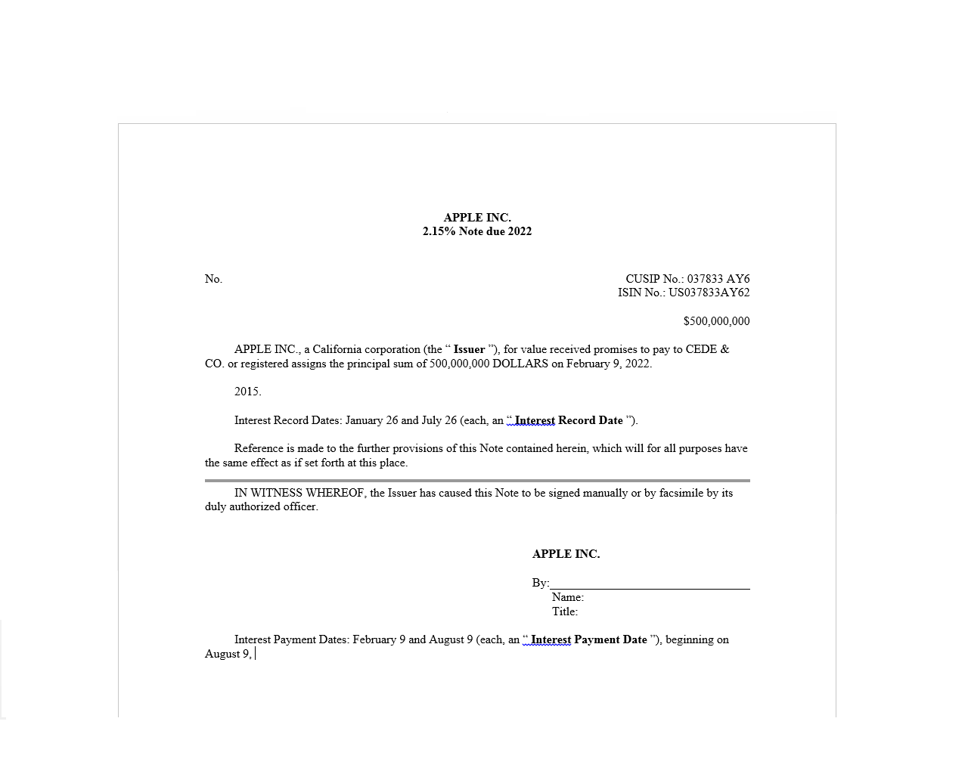

Slide 15
debentures (i.e. bonds) cont
3. However, a debenture does not include
(a) …
(b) an undertaking by a Financial Institution … to repay money deposited with it, or lent to it, in the ordinary course of its banking business;
(c) an undertaking to pay money under -
(i) a cheque; … (iii) bill of exchange …
company registers (s.81)
81(2) For the purposes of this Part, [Part 9 Co Registers] choses in action … that fall into one of the exceptions in paragraphs (a), (b), (c) and (d) of the definition of Debenture in section 3 must also be entered into the register of Debenture Holders.
surely not?

Slide 16
debentures (i.e. bonds) cont
PART 27—DEBENTURES
a trustee is classically used to hold security for bondholders
now mandatory – even if unsecured bonds
public co must enter into trust deed prior to deb issue (s.295)
(nothing new here e.g. Trust Indenture Act 1939 (USA))
function of Trustee
- to hold security if any
- to monitor issuer
- to facilitate group decisions

Slide 17
debentures (i.e. bonds) cont
duties of issuer
- permit audit by trustee (s.302)
- report to trustee any grant of security (s.306)
- quarterly report to Trustee re
- any act of default
- material adverse development
duties of Trustee
to actively police covenants (s.313)
also provisions for meeting of deb holders to issue directions to trustee

Slide 18
issues to the public
the general propositions:
Private co cannot offer securities to the public.
Public issues to utilize prospectus.

Slide 19
issues to the public cont
PART 26 - CAPITAL RAISINGS
offer to the public to be made under a prospectus (s.283(1))
prospectus mandatory content (Schedule 3)
and registered with Reserve Bank (s.284)
exceptions:
283(3)(a) the offer is a personal offer and none of the offers results in Securities being issued … to more than 20 investors having an aggregate issue … price of more than $1 million in a 12 month period;
283(3)(b) the minimum amount payable for the Securities on acceptance of the offer by a person to whom the offer is made is at least $200,000;

Slide 20
issues to the public cont
further exceptions:
- offer to certified sophisticated investor (s.283(3)(c))
- offer of debt securities by Financial Institution (s.283(3)(h))
- offer by Government, Government entity, Reserve Bank (s.283(4))
rights offering by public company may be made under:
- Prospectus (Sch 3)
- or Offer Document (Sch 4) (s.285)

Slide 21
issues to the public cont
‘offer to the public’ defined both s.3 and s.283(2)
3. ‘Offer to the Public’ includes … the making of, an offer/invitation to any section of the public …
and notwithstanding that the offer is capable of acceptance only by each person to whom it is made
but a bona fide offer or invitation is not taken to be an offer or invitation the public if it is -
… (b) a personal offer that is made to not more than 10 members of the public or if the personal offer is made to more than 10 members of the public, the offer is made with a view to it being accepted by not more than 10 members of the public in any 6 month period;
… (d) an offer or invitation issued to existing Members or Debenture Holders of a Company and relates to Shares in, or Debentures of, that Company;
(e) an offer or invitation to subscribe for Securities where the amount to be purchased by each person to whom the offer or invitation is addressed is at least $200,000;
283(2) In this Part, [Part 26] ‘offer to the public’ means an offer of Securities to -
(a) any section of the public, however selected;
(b) individual members of the public, however selected;

Slide 22
issues to the public cont
some tension s.3 and Part 26
3. ‘…but a bona fide offer or invitation is not taken to be an offer or invitation the public if it is
… (b) a personal offer that is made to not more than 10 members of the public or if the personal offer is made to more than 10 members of the public, the offer is made with a view to it being accepted by not more than 10 members of the public in any 6 month period;
283(3) An offer of Securities to the Public may be made without a Prospectus if -
(a) the offer is a personal offer and none of the offers results in Securities being issued … to more than 20 investors having an aggregate issue … price of more than $1 million in a 12 month period;

Slide 23
issues to the public cont
some tension cont
3. …but a bona fide offer or invitation is not taken to be an offer or invitation the public if it is
… (e) an offer or invitation to subscribe for Securities where the amount to be purchased by each person to whom the offer or invitation is addressed is at least $200,000;
283(3) An offer of Securities to the Public may be made without a Prospectus if -
(b) the minimum amount payable for the Securities on acceptance of the offer by a person to whom the offer is made is at least $200,000;

Slide 24
prospectus liability
PART 43 - OFFENCES
Division 4 - Offences in Relation to Disclosure Documents
criminal penalty ($300)
s.660 prohibits offer of securities under a ‘disclosure document’ where DD
- contains misleading or deceptive statement
- or omits material required by Act
- or new cirs post lodgement
civil liability
s.661 party suffering loss where contravention s.660
may recover the loss from
- each director
- the underwriter
- named (consenting) expert

Slide 25
prospectus liability cont
the due diligence defence
s.662 not liable under s.661 re misleading or deceptive statement if
- made all enquires that reasonable in the circumstances
- believed the statement was not misleading or deceptive
- did so on reasonable grounds
re due diligence and reliance on third parties
s.663 not liable under s.661 re misleading or deceptive statement or omission if
- placed reasonable reliance on information given … by another person

Slide 26
prospectus liability cont
some confusion in ss.662 and 663
Due diligence defence for Bidder’s Statement and Target’s Statement
662. A person … is not liable under section 661 … because of a misleading or deceptive statement in a Prospectus or Bidder’s Statement or Target’s Statement if the person proves …’
General defences for all Disclosure Documents
663(1) A person … is not liable under section 661 because of a misleading or deceptive statement in, or an omission from, a Disclosure Document if the person proves …’
3. ‘Disclosure Document’ means a Prospectus, Offer Document, Bidder’s Statement or Target’s Statement;

Slide 27
Part Two
securities and what’s really new

Slide 28
some background
Foundation of limited liability
is co laws one big idea:
co is a legal person separate and distinct from its members.
Hence the trilogy:
- s.h. owns the co
- co owns the business
- s.h. does not own the business
‘the business’ – a collection of assets and liabilities

Slide 29
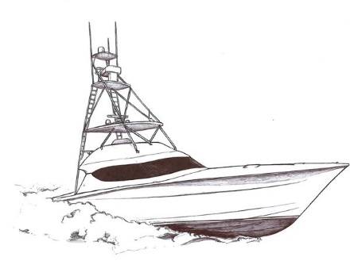
permissible?
X Bankco
guarantee (gratuitous)
business
Aco

Slide 30
permissible?
Xco Bankco
guarantee (gratuitous)
business
but see s.117
Aco

Slide 31
What can the co hand to members?
profits
1983 Act – divs only paid from profits (com law rule)
2015 Act s.207
Another way to put the point:
- co cannot buy back its own shares
- cannot provide fin assistance for purchase its own shares
These the classical capital maintenance rules.

Slide 32
So what’s really new in 2015 Act?
The capital maintenance rules are abandoned.
co can buy back its own shares (Part 18 Div 3)
co can provide fin assistance to party purchasing its own shares (Div 6)

Slide 33
Good idea?
Who was busy buying back their own shares in January 2008?
Starts with ‘L’
the case of Citibank
2006: repurchasing shares at $45-$55 per share.
Late 2007: looking for Saudi bailout – issuing 11% pref shares.
Late 2008: shares trading ˂ $1
2009: issuing shares to US Govn at $2.50 per share
(plus Govn guarantee of $300 billion of ‘toxic assets’)
(plus various emergency funding lines with Fed)
(etc etc)

Slide 34
2014 Glencore plc does $1 billion buyback Sept 2015 announces fresh issue up to $2.5 billion

Slide 35
the details on buybacks
buy-back procedure
equal buy-back requires ord resolution (s.221)
the creditor safeguards
221(1)(a) the Buy-back does not materially prejudice the Company’s ability to pay its creditors;
221(1)(b) the Company will remain solvent immediately after the Buy-back of its own shares;
‘materially prejudice’ means?
10/11/15 McDonalds announces $10 billion buyback
10/11/15 S&P announces downgrade from A- to BBB+
‘solvent’ means commercially solvent (s.3)

Slide 36
‘innovative finance’
The Deal
Raj owns Xco
Xco owns a tourist resort business
Raj puts Xco up for sale
Raj and Joeli agree price of $1 million
Cash sale
Joeli has $200,000
Both parties utilize holding cos

Slide 37
‘innovative finance’ cont the classic transaction
Raj Joeli
Bank
$200,000
business
Raj Joeli
guarantee
Bank
mortgage
$1 m
business
RHco
JHco
RHco
JHco
Xco
Xco

Slide 38
‘innovative finance’ cont innovative transaction 1
utilising a buyback (s.221)
Step one
Xco borrows $500,000 from Bank
borrowing secured on Xco’s assets
Xco buys back half of outstanding shares from RHco
Step two
JHco borrows $300,000 from Bank
borrowing secured on JHco’s assets
plus guarantee of Joeli
JHco purchases shares held by RHco for $500,000

Slide 39
‘innovative finance’ cont
Raj Joeli
guarantee $300,000
Bank
mort $300,000
$500,000
+
$500,000 Bank
mort $500,000
business
RHco
JHco
Xco

Slide 40
‘innovative finance’ cont innovative transaction 2
utilizing financial assistance of Xco (s.233)
Xco borrows $800,000 from Bank
borrowing secured on Xco’s assets
funds onward lent to JHco
ord resolution of Xco approves financial assistance
Director’s resolutions of Xco validated by s.117
JHco purchases all issued shares of Xco from RHco for $1 m.

Slide 41
comment
In the classic transaction Joeli is exposed to risk on Bank debt of $800,000.
In innovative transaction 1 the exposure is $300,000.
In innovative transaction 2 the exposure is nil.
Both ‘innovative’ transactions shift the risk to unsecured creditors of Xco.
Limited liability protects Joeli from claims of Xco creditors.
Simultaneously Xco’s assets are used to complete the deal.
This sounds too good to be true, thus shouldn’t be true. But it is.
Share buybacks and financial assistance enable the capital flexibility of partnership without demanding the partnership price, viz unlimited liability.

Slide 42
comment re s.233
Section 233 provides a company may provide financial assistance to a person to purchase shares of the company if approved by an ord resolution.
But with this limitation: the person acquiring the shares cannot vote.
The limitation is misconceived. The party exiting the company (the seller) is receiving the benefit of the financial assistance just as much as the buyer. The seller too should be barred from voting on the ord resolution.

Slide 43
to conclude
What is truly new in the 2015 Cos Act re securities is the abandonment of the capital maintenance rules.
This ensures (for better or for worse) new opportunities in financing corporate deal making.

Slide 44
Footnote re s.663
Proof readers pull an all-nighter.
s.663(3)(4)and(5)
(3) A person who is named in a disclosure document as—
(a) being a proposed Director or underwriter;
(b) making a statement included in the document; or
(c) making a statement on the basis of which a statement is included in the document.
(4) does not commit an offence against section 660, and is not liable under section 661 for a contravention of section 660, because of a misleading or deceptive statement in, or an omission from, a Disclosure Document if the person proves that they publicly withdrew their consent to being named in the document in that way.
(5) A person does not commit an offence against section 660, and is not liable under section 661 for a contravention of section 660, because of a new circumstance that has arisen since the Disclosure Document was Lodged if the person proves that they were not aware of the matter.

Slide 46
not my mandate
It’s not my mandate to look at Schedule 2.
Notwithstanding, here are some gratuitous comments.
Schedule 2 provides a standard form set of articles that promoters may use if they choose when forming a company (see s.21(2)).

Slide 47
5 reasons not to use Sch 2 when forming a co
Reason No. 1: RRRepetition
Cf articles 3 and 21
Article 3
(1) The business of a Company is to be managed by or under the direction of the Directors.
(2) The Directors may exercise all the powers of the Company except any powers that this Act or the Company’s Articles of Association require the Company to exercise in General Meeting.
Article 21
(1) The business of the Company is managed by the Directors who may exercise all powers of the Company that this Articles of Association or the Companies Act do not require to be exercised by the Company in General Meeting.

Slide 48
5 reasons not to use Sch 2 when forming a co
Reason No. 1 cont
Cf. articles 60(4) and 62(1)
Article 60(4)
(4) A transferor of Shares remains the holder of the Shares transferred until the transfer is registered and the name of the transferee is entered in the Register in respect of the Shares.
Article 62(1)
(1) A person transferring Shares remains the holder of the Shares until the transfer is registered and the name of the person to whom they are being transferred is entered in the register of members in respect of the Shares.

Slide 49
5 reasons not to use Sch 2 when forming a co
Reason No. 1 cont
Cf. articles 61(1) and 62(2)
Article 61(1)
(1) Subject to clause 63, the Directors are not required to register a transfer of Shares unless —
(a) the transfer is left at the Company’s Registered Office;
(b) the transfer is accompanied by a certificate for the Shares dealt with in the transfer, unless the Directors waive production of the certificate on receiving satisfactory evidence of the loss or destruction of the certificate; and
(c) the Directors have been provided with any further information they reasonably require to establish the right of the person transferring the Shares to make the transfer.
Article 62(2)
(2) The Directors are not required to register a transfer of Shares in the Company unless —
(a) the transfer and any Share certificate have been Lodged at the Company’s Registered Office;
(b) any fee payable on registration of the transfer has been paid; and
(c) the Directors have been given any further information they reasonably require to establish the right of the person transferring the Shares to make the transfer.

Slide 50
5 reasons not to use Sch 2 when forming a co
Reason No. 2: articles cannot contradict the Act
Cf Act s.191(2) and article 32(2)
Act s.191(2)
(2) A Company can issue preference shares only if the rights attached to the preference shares with respect to the following matters are set out in the Company’s Articles of Association or have been otherwise approved by Special Resolution of the Company —
(a) repayment of capital;
(b) participation in surplus assets and profits;
(c) cumulative and non-cumulative dividends;
(d) voting; and
(e) priority of payment of capital and dividends in relation to other shares or classes of preference shares.
Article 32
32.—(1) Subject to this Articles of Association and the Companies Act, the Directors may issue or dispose of Securities to persons —
(a) on terms determined by the Directors;
(b) at the issue price that the Directors determine; and
(c) at the time that the Directors determine.
(2) The Directors’ power under sub-clause (1) includes the power to —
(a) …
(b) issue other Securities with —
(i) any preferential, deferred or special rights, privileges or conditions;
(ii) any restrictions in regard to dividend, voting, return of capital or otherwise; or
(iii) issue preference Shares or other Securities that are liable to be redeemed.

Slide 51
5 reasons not to use Sch 2 when forming a co
Reason No. 3: am I reading the Act or the articles?
Article 30(1)
30(1) This section applies to resolutions of the members of Private Companies that the Companies Act or the Company’s Articles of Association requires or permits to be passed at a General Meeting. It does not apply to a resolution under section 427 to remove an Auditor.
Article 30(5)
(5) A Company that passes a resolution under this section without holding a meeting
satisfies any requirement in this Act —
(a) to give members information …
Article 67(4)
(4) This section has effect subject to the Bankruptcy Act (Cap. 48).

Slide 52
5 reasons not to use Sch 2 when forming a co
Reason No. 4: definite and indefinite articles [cf the house and a house): are these the articles of our company?
Errors in bold for convenience.
Article 5(2)
(2) The Directors of a Company may confer on a managing director any of the powers that the Directors can exercise.
Article 10
10. A Company may appoint a person as a Director by resolution passed in General Meeting.
Article 11(1)
11(1) The Directors of a Company may appoint a person as a Director.
There are countless examples like those above.
But sometimes the articles read as the articles of an actual real company.
e.g. article 9
9. The initial Directors of the Company are the persons who have consented to act as Directors and are set out in the Company’s application for registration as a company. Those persons hold office subject to this Articles of Association.

Slide 53
5 reasons not to use Sch 2 when forming a co
Reason No. 5: Sch 2 cannot be used for a public company.
Schedule 2 is intended to accommodate all different categories of companies (see article 2(3)-(6)). However, article 32 incorporates into the articles of all cos with a share capital the limitations unique to a private company (s.16).
Article 32(3) and (4)
(3) The Company must not make an offer to the public of Shares.
(4) The number of members in the Company must be limited to 50, not including persons who are in the employment of the Company and persons who, having been formerly in the employment of the Company, were, while in that employment and have continued, after the determination of that employment, to be, members of the Company.

Slide 54
5 reasons not to use Sch 2 when forming a co
Bonus Reason: schoolboy drafting about generous members
Article 6(2)
(2) The members of the Company may also pay the Directors’ travelling and other expenses that they properly incur -
(a) in attending Directors’ meetings …

